Slide 1
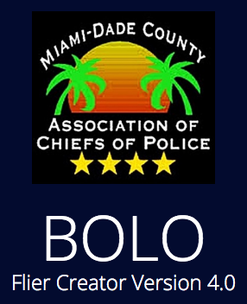
Senior Project Final Presentation Spring 2016
Team Members: Leonardo Martin, Edwin Alvarez, Alejandro Henao, Piero Messarina Product Owners: Chief Samuel Ceballos, Major Jason Cohen Mentors: Juan Caraballo, Robert Loredo Instructor: Masoud Sadjadi
School of Computing and Information Sciences Florida International University
May 6th, 2016
Notes:
Greet your audience, thank them for attending your presentation, introduce yourself, introduce your project, introduce your team members, and quickly indicate what each of you did in a high-level manner, and put more emphasis on your part/contribution.

Slide 2
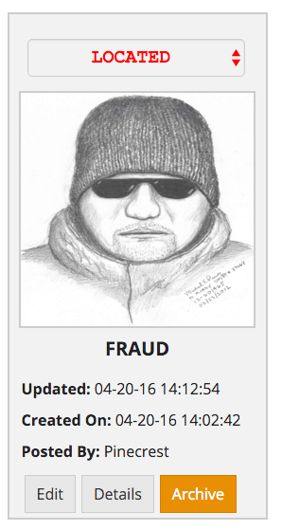
Problem definition
Village of Pinecrest Police Department needs a way to create and distribute information on crime throughout their agency
They distribute BOLO (Be On the LookOut) fliers contain sensitive crime information
Process is slow and inefficient
Notes:
Introduce the problem that the whole project tackles and stay focused on the parts that you have been working. Indicate if there is an existing previous system, enumerate its problems/limitations, etc.

Slide 3
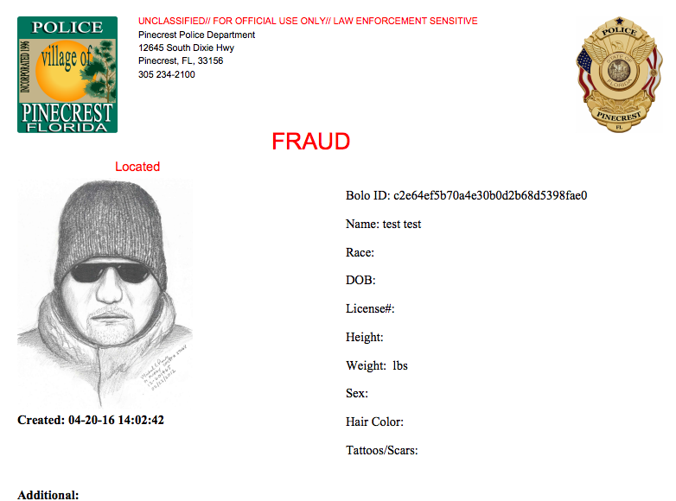
Problem definition
Current system: BOLO 2.0
Allows for real time BOLO sharing. However,
Not scalable
Not secure
Lacks necessary features
Needs stable platform

Slide 4
Solution
The BOLO Flier Creator is an application that aims to facilitate the process of creating and distributing Be On the Look Out information.
My Part:
User interface customization
Rework of system design for user permissions
End-To-End development of update-button
End-To-End development for edit BOLO
End-To-End development for agency management
End-To-End development for forgot-password flow
Notes:
Introduce the problem that the whole project tackles and stay focused on the parts that you have been working. Indicate if there is an existing previous system, enumerate its problems/limitations, etc.

Slide 5
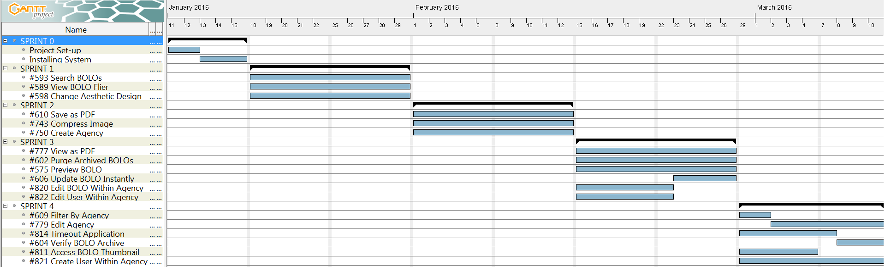
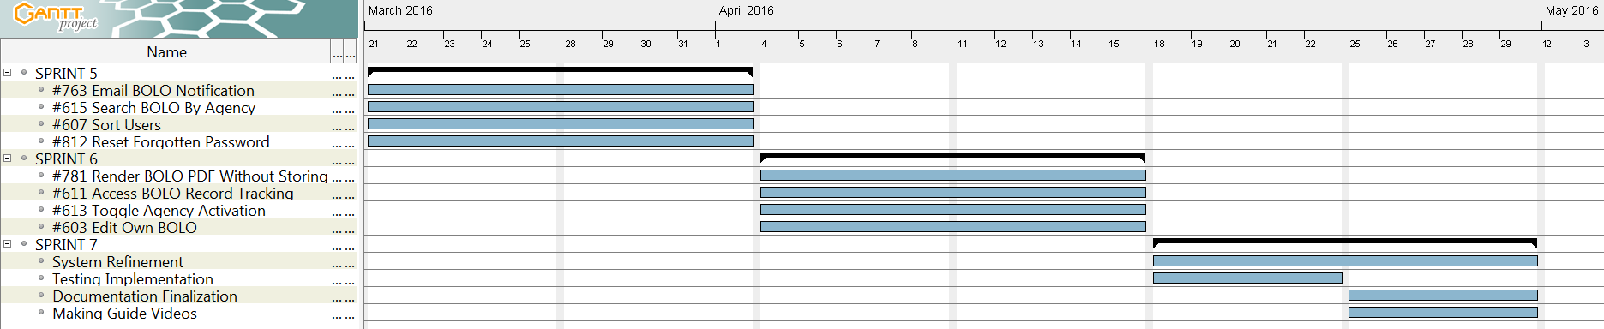
Project Management
Notes:
Project Management (schedule for entire semester) (one slide; Gantt Chart).

Slide 6











Slide 7
System Design: Architecture
Domain Driven Design (DDD)
Hexagonal Architecture (version of 3 tiered)
Notes:
5. System design:
5.1. System decomposition; identify the architecture patterns used (one slide).
5.2. System deployment – h/w and s/w requirements (one slide).
5.3. Persistent data design (one slide).
5.4. Security/Privacy (one slide).

Slide 8
System Design: Deployment
Notes:
5. System design:
5.1. System decomposition; identify the architecture patterns used (one slide).
5.2. System deployment – h/w and s/w requirements (one slide).
5.3. Persistent data design (one slide).
5.4. Security/Privacy (one slide).

Slide 9
Minimal Class Diagram

Slide 10
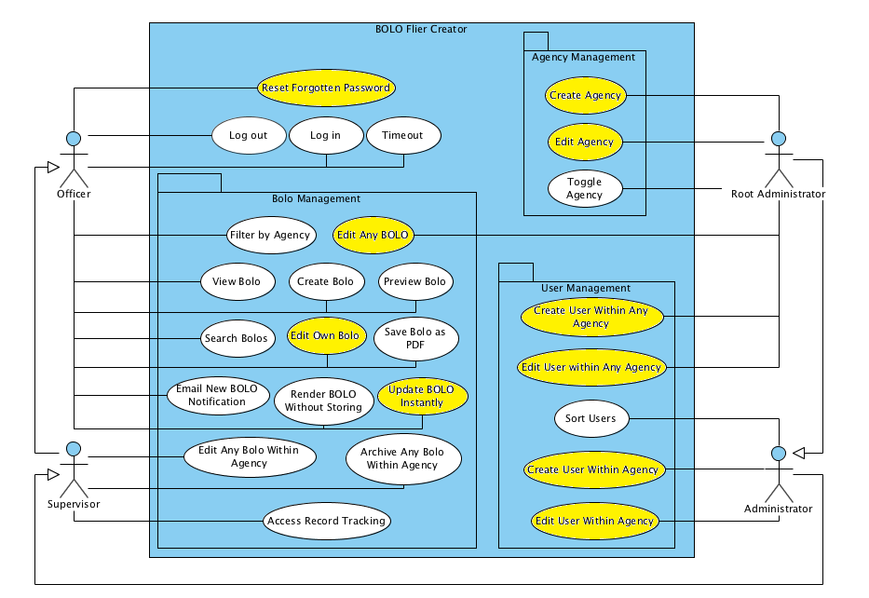
Requirements: Use Cases
Notes:
4. Requirements:
4.1. User stories implemented (one or more slides).
4.2. UML use cases and the use case diagram for the implemented use cases (one or more slides).
4.3. UML sequence diagrams for the implemented use cases.

Slide 11
Requirements: User Stories
[US 598] Change Aesthetic Design of System
[US 603] Edit Own BOLO
[US 606] Update BOLO instantly
[US 750] Create Agency
[US 812] Reset Forgotten Password
[US 820] Edit BOLO Within Agency
[US 821] Create User Within Agency
Notes:
4. Requirements:
4.1. User stories implemented (one or more slides).
4.2. UML use cases and the use case diagram for the implemented use cases (one or more slides).
4.3. UML sequence diagrams for the implemented use cases.

Slide 12
Most Significant Use Case
Use case Bolo-750: Create Agency
Description: As a Root Administrator, I would like to be able to create agencies, so that agencies can be added to the system in the case where the customer base of the system is expanded.
Relevant Precondition:
There must exist a Root Administrator seeded in the system
Flow of events:
The user clicks the ‘Admin’ tab
The user clicks the ‘Agency Management’ link
The user clicks the ‘Add New Agency’ button
The user fills out all of the fields on the page
The user clicks the ‘Submit’ button
Post-Conditions
The system displays the new agency amongst the current list of existing agencies

Slide 13
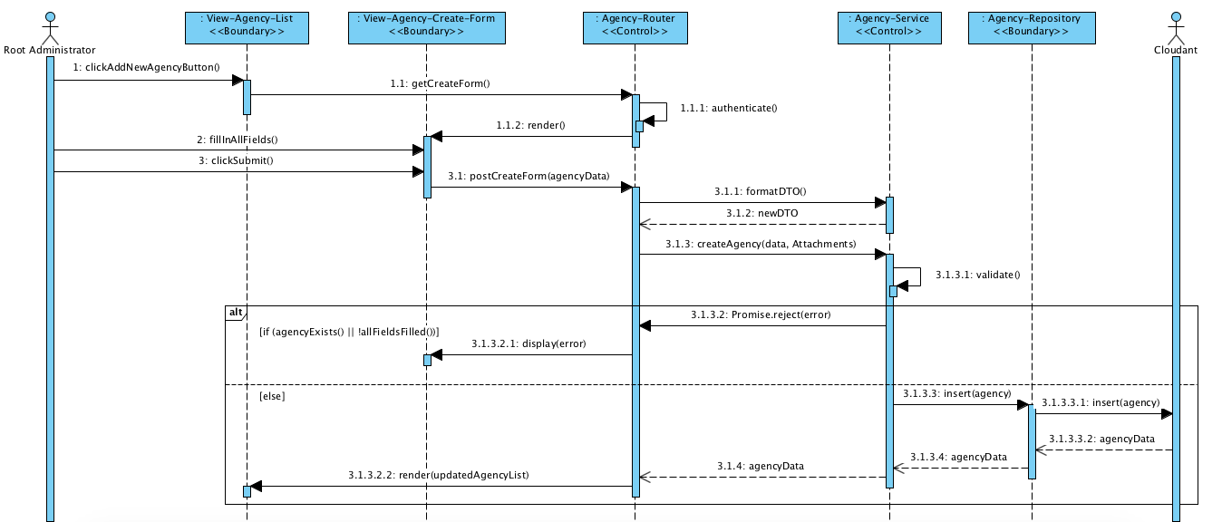
Most Significant Use Case

Slide 14
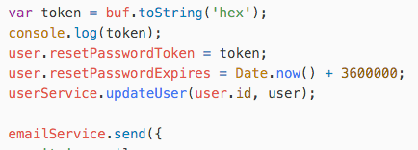
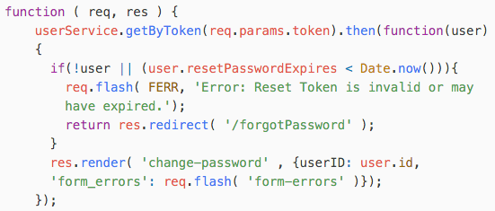
Interesting Algorithm
Generate unique token
Generate timestamp (current time + 1 hour)
Update user with 1 & 2
Send email to user with link containing token from 1
User clicks link
If the token does not exist OR the timestamp has expired, display error.
else, allow user to change password.

Slide 15
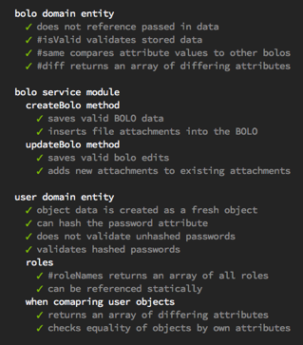
Test Suites and Test Cases
Mocha Javascript Test Framework
Chai assertion library
Unit and integration tests
Cloudant behavior tested alongside code

Slide 16
Sunny Day
Test ID: U-812-1
Purpose: Tests that if the user provides an email that is registered in the system, the function getByEmail(email) will return the user that the email corresponds to.
Preconditions: System must be functional; User "testUser" must exist in database. testUser = { "username": "testUser", "password": "Password1!", "fname" : "test", "lname" : "user", "email": "test@example.com", "tier": 1, "agency": "testAgency123", "agencyName" : "testAgency123" }
Input: userRepository.getByEmail("test@example.com");
Expected Output: testUser

Slide 17
Rainy Day
Test ID: U-812-2
Purpose: Tests that if the user provides an email that is not registered in the system, the function will return null.
Preconditions: System must be functional; User "testUser" must exist in database. testUser = { "username": "testUser", "password": "Password1!", "fname" : "test", "lname" : "user", "email": "test@example.com", "tier": 1, "agency": "testAgency123", "agencyName" : "testAgency123" }
Input: userRepository.getByEmail("test1@example.com");
Expected Output: null

Slide 18
Summary
BOLO 4.0 will help law enforcement agents in speeding up their crime information sharing.
My contribution:
User interface customization
Rework of system design for user permissions
End-To-End development of update-button
End-To-End development for edit BOLO
End-To-End development for agency management
End-To-End development for forgot-password flow
Notes:
Summarize your contribution
Include your contact information
Ask if anyone has any questions for you.
Thank your audience

Slide 19
How to Contact
Email:
lmart296@fiu.edu
LinkedIn:
linkedin.com/in/lmart296
Github:
github.com/lmart296

Slide 20
Questions

